Slide 1

Cloud Computing MapReduce, Batch Processing
Eva Kalyvianaki ek264@cam.ac.uk

Slide 2
Contents
Batch processing: processing large amounts of data at-once, in one-go to deliver a result according to a query on the data.
Material is from the paper:
“MapReduce: Simplified Data Processing on Large Clusters”,
By Jeffrey Dean and Sanjay Ghemawat from Google
published in Usenix OSDI conference, 2004
2

Slide 3
Motivation: Processing Large-sets of Data
Need for many computations over large/huge sets of data:
Input data: crawled documents, web request logs
Output data: inverted indices, summary of pages crawled per host, the set of the most frequent queries in a given day, …
Most of these computation are relatively straight-forward
To speedup computation and shorten processing time, we can distribute data across 100s of machines and process them in parallel
But, parallel computations are difficult and complex to manage:
Race conditions, debugging, data distribution, fault-tolerance, load balancing, etc
Ideally, we would like to process data in parallel but not deal with the complexity of parallelisation and data distribution
3

Slide 4
MapReduce
“A new abstraction that allows us to express the simple computations we were trying to perform but hides the messy details of parallelization, fault-tolerance, data distribution and load balancing in a library.”
Programming model:
Provides abstraction to express computation
Library:
To take care the runtime parallelisation of the computation.
4
Notes:
Managing of Parallelization, Fault Tolerance, Data Distribution and Load Balancing is invisible to the user and comes free
Motivation: primarily meant for Google’s web indexing
Once the documents are crawled
Several mapreduce operations are run in sequence to index documents
From the MapReduce paper notes presentation

Slide 5
Example: Counting the number of occurrences of each work in the text below from Wikipedia
“Cloud computing is a recently evolved computing terminology or metaphor based on utility and consumption of computing resources. Cloud computing involves deploying groups of remote servers and software networks that allow centralized data storage and online access to computer services or resources. Cloud can be classified as public, private or hybrid.”
Word: Number of Occurrences
Cloud 1
computing 1
is 1
a 1
recently 1
evolved 1
computing 1?
terminology 1
2
5

Slide 6
Programming Model
Input: a set of key/value pairs
Output: a set of key/value pairs
Computation is expressed using the two functions:
Map task: a single pair → a list of intermediate pairs
map(input-key, input-value) → list(out-key, intermediate-value)
<k_{i}, v_{i}> → { < k_{int}, v_{int} > }
Reduce task: all intermediate pairs with the same k_{int} → a list of values
reduce(out-key, list(intermediate-value)) → list(out-values)
< k_{int}, {v_{int}} > → < k_{o}, v_{o} >
6

Slide 7
Example: Counting the number of occurrences of each work in a collection of documents
map(String input_key, String input_value):
// input_key: document name
// input_value: document contents
for each word w in input_value:
EmitIntermediate(w, "1");
reduce(String output_key, Iterator intermediate_values):
// output_key: a word
// output_values: a list of counts
int result = 0;
for each v in intermediate_values:
result += ParseInt(v);
Emit(AsString(result));
7

Slide 8
MapReduce Example Applications
The MapReduce model can be applied to many applications:
Distributed grep:
map: emits a line, if line matched the pattern
reduce: identity function
Count of URL access Frequency
Reverse Web-Link Graph
Inverted Index
Distributed Sort
….
8

Slide 9
MapReduce Implementation
MapReduce implementation presented in the paper matched Google infrastructure at-the-time:
Large cluster of commodity PCs connected via switched Ethernet
Machines are typically dual-processor x86, running Linux, 2-4GB of mem! (slow machines for today’s standards)
A cluster of machines, so failures are anticipated
Storage with (GFS) Google File System (2003) on IDE disks attached to PCs. GFS is a distributed file system, uses replication for availability and reliability.
Scheduling system:
Users submit jobs
Each job consists of tasks; scheduler assigns tasks to machines
9

Slide 10
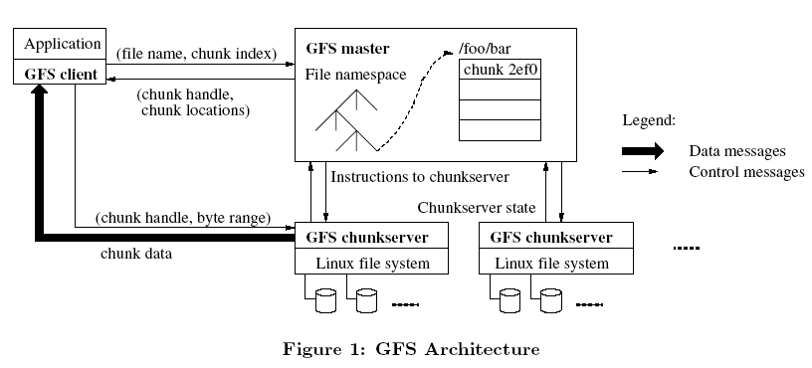
Google File System (GFS)
File is divided into several chunks of predefined size;
Typically, 16-64 MB
The system replicates each chunk by a number:
Usually three replicas
To achieve fault-tolerance, availability and reliability
10

Slide 11
Parallel Execution
User specifies:
M: number of map tasks
R: number of reduce tasks
Map:
MapReduce library splits the input file into M pieces
Typically 16-64MB per piece
Map tasks are distributed across the machines
Reduce:
Partitioning the intermediate key space into R pieces
hash(intermediate_key) mod R
Typical setting:
2,000 machines
M = 200,000
R = 5,000
11

Slide 12
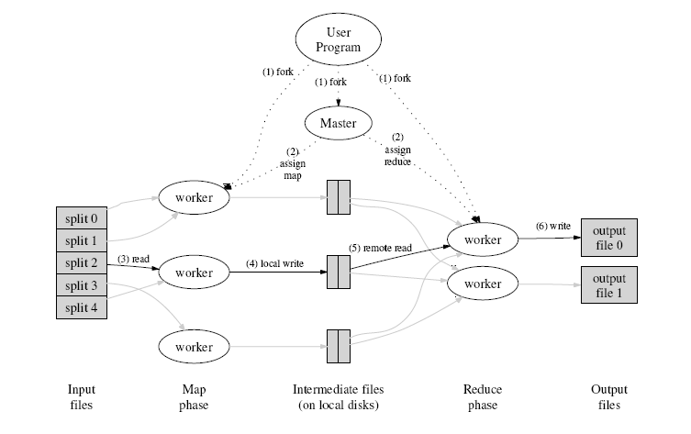
Execution Flow
12
Notes:
Best-effort round robin
Hard-requirement earliest deadline first

Slide 13
Master Data Structures
For each map/reduce task:
State status {idle, in-progress, completed}
Identity of the worker machine (for non-idle tasks)
The location of intermediate file regions is passed from maps to reducers tasks through the master.
This information is pushed incrementally (as map tasks finish) to workers that have in-progress reduce tasks.
13

Slide 14
Fault-Tolerance
Two types of failures:
worker failures:
Identified by sending heartbeat messages by the master. If no response within a certain amount of time, then the worker is dead.
In-progress and completed map tasks are re-scheduled → idle
In-progress reduce tasks are re-scheduled → idle
Workers executing reduce tasks affected from failed map/workers are notified of re-scheduling
Question: Why completed tasks have to be re-scheduler?
Answer: Map output is stored on local fs, while reduce output is stored on GFS
master failure:
Rare
Can be recovered from checkpoints
Solution: aborts the MapReduce computation and starts again
14
Notes:
Map tasks write their outputs on temporary files

Slide 15
Disk Locality
Network bandwidth is a relatively scarce resource and also increases latency
The goal is to save network bandwidth
Use of GFS that stores typically three copies of the data block on different machines
Map tasks are scheduled “close” to data
On nodes that have input data (local disk)
If not, on nodes that are nearer to input data (e.g., same switch)
15

Slide 16
Task Granularity
Number of map tasks > number of worker nodes
Better load balancing
Better recovery
But, this, increases load on the master
More scheduling
More states to be saved
M could be chosen with respect to the block size of the file system
For locality properties
R is usually specified by users
Each reduce tasks produces one output file
16

Slide 17
Stragglers
Slow workers delay overall completion time → stragglers
Bad disks with soft errors
Other tasks using up resources
Machine configuration problems, etc
Very close to end of MapReduce operation, master schedules backup execution of the remaining in-progress tasks.
A task is marked as complete whenever either the primary or the backup execution completes.
Example: sort operation takes 44% longer to complete when the backup task mechanism is disabled.
17

Slide 18
Refinements: Partitioning Function
Partitioning function identifies the reduce task
Users specify the desired output files they want, R
But, there may be more keys than R
Uses the intermediate key and R
Default: hash(key) mod R
Important to choose well-balanced partitioning functions:
hash(hostname(urlkey)) mod R
For output keys that are URLs
18

Slide 19
Refinements: Combiner Function
Introduce a mini-reduce phase before intermediate data is sent to reduce
When there is significant repetition of intermediate keys
Merge values of intermediate keys before sending to reduce tasks
Example: word count, many records of the form <word_name, 1>. Merge records with the same word_name
Similar to reduce function
Saves network bandwidth
19

Slide 20
Evaluation - Setup
Evaluation on two programs running on a large cluster and processing 1 TB of data:
grep: search over 10¹⁰ 100-byte records looking for a rare 3-character pattern
sort: sorts 10¹⁰ 100-byte records
Cluster configuration:
1,800 machines
Each machine has 2 GHz Intel Xeon proc., 4GB mem, 2 160GB IDE disks
Gigabit Ethernet link
Hosted in the same facility
20

Slide 21
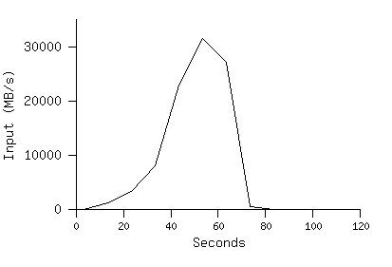
Grep
M = 15,000 of 64MB each split
R = 1
Entire computation finishes at 150s
Startup overhead ~60s
Propagation of program to workers
Delays to interact with GFS to open 1,000 files
…
Picks at 30GB/s with 1,764 workers
21

Slide 22
Sort
M = 15,000 splits, 64MB each
R = 4,000 files
Workers = 1,700
Evaluated on three executions:
With backup tasks
Without backup tasks
With machine failures
22

Slide 23
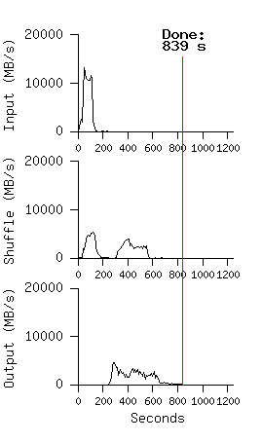
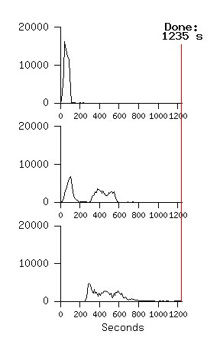
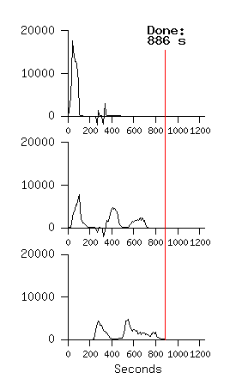
Sort Results
Top: rate at which input is read
Middle: rate at which data is sent from mappers to reducers
Bottom: rate at which sorted data is written to output file by reducers
Normal execution with backup
Without backup tasks, 5 reduce tasks stragglers, 44% increase
With machine failures,
200 out of 1746 workers,
a 5% increase over normal execution time
23
Notes:
Top: rate at which input is read

Slide 24
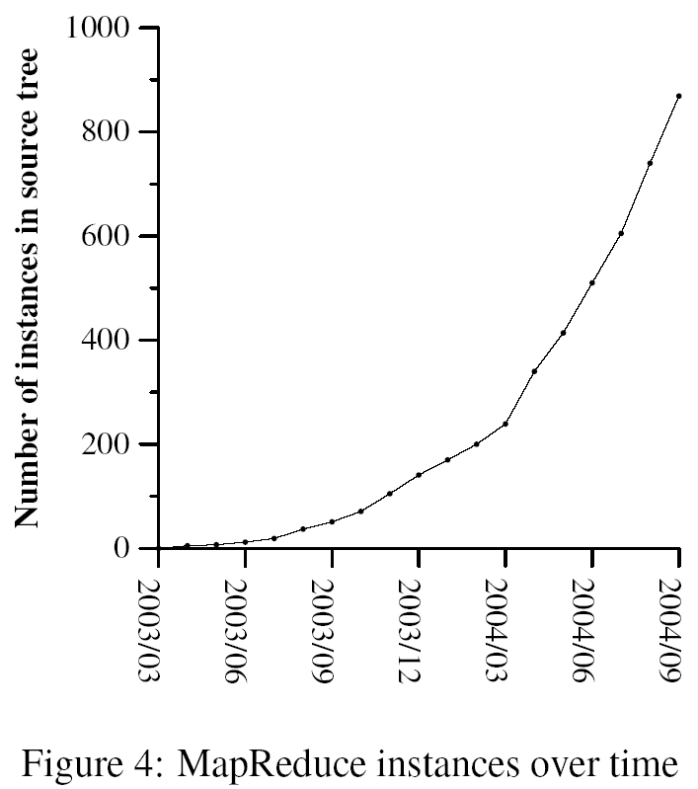
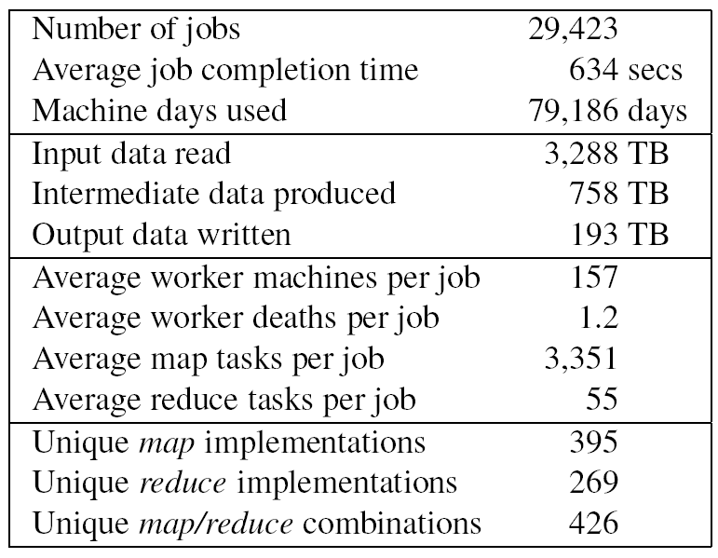
Implementation
First MapReduce library in 02/2003
Use cases (back then):
Large-scale machine learning problems
Clustering problems for the Google News
Extraction of data for reports Google zeitgeist
Large-scale graph computations
MapReduce jobs run in 8/2004
24

Slide 25
Summary
MapReduce is a very powerful and expressive model
Performance depends a lot on implementation details
Material is from the paper:
“MapReduce: Simplified Data Processing on Large Clusters”,
By Jeffrey Dean and Sanjay Ghemawat from Google
published in Usenix OSDI conference, 2004
25

